Slide 1
Proudly Sponsored by:

Slide 2
Committee

Slide 3
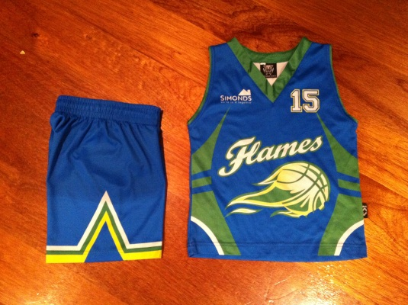
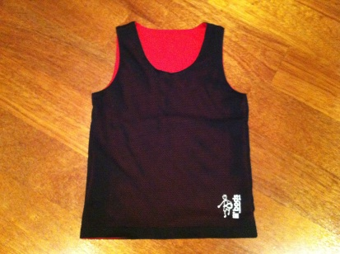
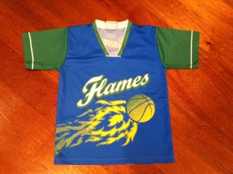
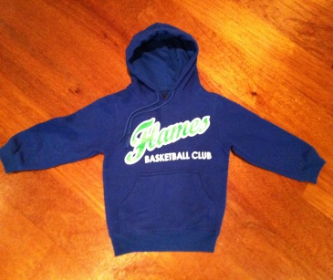
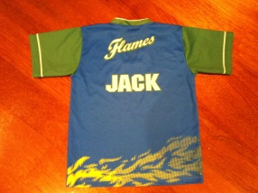
Club Attire
All new players will be required to purchase their uniform (singlet and shorts), for the cost of $80.
Any existing players who require a new uniform, will need to purchase it for the cost of $80.
Game day singlets and shorts can be purchased separately for a cost of $40 each.
Game Day Uniform
Game Day uniform consists of a game day singlet and shorts
It is a requirement for each player to wear their own uniform to every game · Proper non marking footwear must be worn.
Training Uniform
Reversible singlets must be worn to each training session. Reversible singlets can be purchased for $10. Proper non marking footwear must to be worn
Optional Apparel
Flames Warm Up Tops are available at a cost of $45. These tops can be individualised with players name on back.
Flames Fleecy Hoodies are also available at a cost of $45 each.
For all uniform orders or enquires please email uniforms@marymedebasketballclub.com.au

Slide 4
Training
Players are required to attend a one hour per week training session. All training is held at Marymede Fitness Centre. This is where coaches work on improving skills and techniques. If the player cannot attend for any reason they must contact the team manager before the training session so training plans can be altered.
All players must bring their own ball, drink bottle and reversible training singlet.
All players are to be supervised by a guardian at training.
Game Day
All Under 8’s Games are played at Marymede Fitness Centre
Williamson Rd South Morang 3752
All other games are played at Mill Park Basketball Stadium
Redleap Reserve Mill Park VIC 3082 (03) 9436 8888
or
Darebin Community Sports Stadium 857 Plenty Road, Reservoir, 3073
All players will be contacted by their team manager of game time. It is imperative that players arrive 10 minutes before match time to ensure players are warmed up and ready to start.
If a player cannot attend the game for any reason their team manager must be contacted as early as possible to allow arrangement of substitute players or for match plans to be altered.
All players are to be supervised by a guardian on game day

Slide 5
Team Selection Process
Coaching Coordinator and Age Group Coordinator attend games and training sessions to watch the children.
Coaches assess players and complete Player Profile Report based on their assessment of player’s performance throughout the season. The Player Profile reports are used as a guide only.
Player Profile Reports are reviewed and discussed by the Coaching and Age Coordinators. Any other issues or concerns that may arise from the discussions are taken back to the coaches for clarification.
Coaching Committee collate information and form teams based on their observations, discussions with coaches and the Player Profile sheets. It is a combination of these three things that determine team selection.
Coaching Coordinator finalises teams.
Please note: During the first four weeks of the season (grading games), teams are still able to be changed, if a change is required. This will only occur if both the Coaching Coordinator and the Age Group Coordinator feel that it is in the best interest of the team and the child to do so.
Any concerns regarding teams or coaches must be addressed to the Age Group Coordinator and Coaching Coordinator via EMAIL only.
Robbie Glass- Coaching Coordinator – coaching@marymedebasketballclub.com.au
Liz Miles – Under 8s Coordinator – coachU8@marymedebasketballclub.com.au
Lincoln Miles – Under 10/12 Boys Coordinator – coachU1012B@marymedebasketballclub.com.au
Narelle Panther – Under 10/12 Girls Coordinator – coachU1012G@marymedebasketballclub.com.au
Stephen Connor – Under 14/16 Boys Coordinator – coachU1416B@marymedebasketballclub.com.au
Maureen Xerri – Under 14/16 Girls Coordinator – coachU1416G@marymedebasketballclub.com.au

Slide 6
Club Insurance
Team Manager
Team managers role is to be the liaison between the club, the coach and the players. All players are to contact the team manager if they cannot attend training and/or game day or have if they have any queries or concerns.
The team manger is to ensure all players have a roster for the season detailing game times and allocating a family member to score at each game. All families must take their turn in scoring. The score sheet is to picked up at the start of each game and checked at the end of the match and handed back to reception. All players need to sign first and last name on the score sheet to ensure they have qualified 7 games to play finals.
The team manager is responsible for organising clash tops when two Marymede teams are competing against each other.
Please contact Angela Roussos on clashtops@marymedebasketballclub.com.au
Tops must be laundered and returned back to Angela at the next training session.
All registered members, coaches, assistant coaches, voluntary workers and team managers are all covered by the Whittlesea City Basketball Associations public liability insurance.
Any queries please email the secretary on: secretary@marymedebasketballclub.com.au
Club Code Of Conduct
Marymede Flames Basketball Club insists that all players and spectators read the code and adhere to the rules. If any member of the Flames community fails to adhere to these rules disciplinary action in the form of suspension of play may occur. This is at the discretion of the committee.

Slide 7
Players Code Of Conduct
Basketball is intended to be a recreational activity for enjoyment and health. This code of conduct has been
developed by Basketball Victoria to give participants some guide to the expectations it has on those
participants. It is intended to assist everyone to obtain the maximum benefit and enjoyment from their
involvement in basketball. As a result, the quality of participation will be improved so people are more likely
to start and continue their involvement in basketball. Enjoy!!
1. Understand and play by the rules.
2. Respect referees and other officials.
3. Control your temper.
4. Work equally hard for yourself and for your team.
5. Be a good sport.
6. Treat all players as you would like to be treated.
7. Play for the “enjoyment of it” and not just to please
parents and coaches.
8. Respect the rights, dignity and worth of every person.
9. Be prepared to lose sometimes.
10. Listen to the advice of your coach and try to apply it
at practice and in games.
11. Always respect the use of facilities and equipment
provided.
The whole code or tribunal by-laws offences policy is available from the Marymede Flames Website.

Slide 8
Spectators Code Of Conduct
Basketball is intended to be a recreational activity for enjoyment and health. This code of conduct has been
developed by Basketball Victoria to give participants some guide to the expectations it has on those
participants. It is intended to assist everyone to obtain the maximum benefit and enjoyment from their
involvement in basketball. As a result, the quality of participation will be improved so people are more likely
to start and continue their involvement in basketball. Enjoy!!
1. Remember that most people play sport for enjoyment.
People are not playing basketball for the entertainment of spectators nor are many of them professionals.
You should be watching basketball for your own enjoyment and to show support for those playing. Help the
players to enjoy their game. Applaud good performances from each team.
Congratulate all players regardless of the outcome.
2. Accept decisions of all referees as being fair and called to the best of their ability.
Referees and officials have a difficult task to perform. You would not have a game to enjoy without them.
They are there to enforce the rules of play but they cannot always be right. Accept bad calls graciously.
Abuse of referees is unacceptable behaviour. Spectators who consistently dispute decisions or do not
accept bad decisions are bad sports. If you disagree with a decision, accept it graciously – you cannot
change it.
3. Always be positive in your support for players.
Never ridicule or shout at a player, particularly a young player for making a mistake during competition.
Positive support for players will offer encouragement to them and most likely spur them to better things on
the court.
4. Condemn the use of violence in any form.
Never encourage players to engage in violence or engage in it yourself. Violence has no place in basketball
and strong action should be taken to discourage it.
5. Respect your team’s opponents, officials and spectators.
Without your team’s opponents, there would be no game. Their supporters are there to enjoy the game as
much as you are. Light-hearted banter with an opposing spectator can add a further element of fun to a
game. Conversely, nasty or inappropriate behaviour or remarks will seriously detract from it.
6. Encourage players to obey the rules and to accept decisions of officials.
Often players can get carried away when spectators become enthusiastic or heated over an issue. This can
be a positive but it can also be negative when it involves such behaviour as disputing decisions. Always
encourage players to obey the rules and do not dispute referees’ decisions.
7. Demonstrate appropriate social behaviour by not using foul language or harassing players, coaches or officials.
Anti social behaviour such as foul or abusive language has no place in basketball. If others engage in it,
just ignore them – they will soon tire of it if they get no reaction. Alternatively, ask them politely to desist. If
it continues and it is serious, bring it to the attention of an official.
8. Respect the rights, dignity and worth of every person. Regardless of their gender, ability, cultural
background, religion or other factor irrelevant to the game, all persons connected with basketball are
entitled to equal treatment and respect. Avoid any remarks that could be construed as offensive or
discriminatory. Sometimes even a joke may give offence. Even if a person refers to themselves with a
particular label, it should not be taken as an invitation for you to do so. Using discretion is imperative and it
is better to err on the side of caution.
9. Keep children in your care under control.
Basketball encourages you to bring your children to games. However, there can be dangers to them in a
basketball stadium. They can also constitute a danger to players. You should ensure that children with you
at a basketball game are well behaved and do not wander onto or too near to courts. They can easily be
knocked down by a player or a player can trip over a child when concentrating on the play and not
expecting a small child to be in the way.
10. Always respect the use of facilities and equipment provided.
Facilities and equipment cost money and will only function properly if kept in good order. Ensure that you
do not abuse anything provided for use. Do not encourage players to engage in dangerous practices such
as hanging off hoops or “slam dunking”. Quite properly, these practices are banned in most venues. Not
only can equipment be damaged but also serious injury can occur.

Slide 9
Media Policy
The era of Social media and mobile phones has meant an explosion of ways for people to
Communicate in electronic form.
While this is positive in terms of being able to communicate efficiently, there is also
concern as electronic communication can be used in a negative way.
Specifically, bullying and harassment as defined under Basketball Victoria’s Member Protect By Laws is just as
damaging via electronic means as it is via face to face communication.
The Club wants to only encourage the positive and appropriate use of electronic messaging in its various
forms and ensure that all participants understand that electronic communication should
always be used in an appropriate manner.
Definition
An electronic message means any text (in any language), symbol or image that can
be seen to convey a message, either directly or indirectly. The guidelines in
this policy apply to electronic messages that can be sent and received using any of the
following channels:
Electronic mail
Texting between mobile phones
On line messaging & social networking (e.g. MSN, MySpace, Facebook)
Interactive messaging through services such as Twitter
Messages posted to any Internet based discussion forum
Content displayed as part of any Web page
Please note that in the context of this policy, all messaging between people using Club or
private email addresses, personal computers and mobile phones is considered included
where the messaging relates to any basketball or related activities that are conducted by
the Club.
All forms of communication contribute to the relationships that need to be built between
players on a basketball team for a positive influence to on court performance. In
particular, players and their parents should understand that all forms of electronic
communication are discoverable and can be used as evidence in a grievance.
This includes all messaging or content that is made about players, parents or teams from both
with the Marymede Basketball Club, as well as players or teams from any
other Clubs or Associations who are a part of the sport.
Breaches of this Policy
All persons (members, players, teams), are expected to respect and treat each other with dignity at all times through all forms of communications.
Any person who inappropriately sends an electronic message or that posts the message on a web page that is abusive, derogatory or discriminatory which involves reference by statement or inference to the club will be subject to disciplinary action or possible expulsion in accordance with the clubs policies
Parents are encouraged to supervise their children’s internet activities and report any inappropriate communications potentially impacting on the Marymede Basketball Club, its players, members and Executive Committee.
Any person that identifies the club name or logo being used inappropriately on the internet and considers this use that may be detrimental to the club is encouraged to report this to the Executive Committee for the appropriate action to be taken.
These policy guidelines have been implemented for the protection of the reputation of the Marymede Basketball Club. They are applicable at all times.

Slide 10
Fee & Refund Policy
Scope
Parent/guardians of Marymede Basketball Club
Objective
For a consistent and communicated approach towards the payment of club fees, bonds and refunds
Implementation
Marymede Basketball Club’s current fee is $165.00 per player, per season. Sibling discounts apply to families who have more than one child playing for the club.
The fee structure is
1st Player $165
2nd Player $150
3rd Player $135
If a player is a permanent player for a second team and as such qualifies to play in the finals, then that player must pay an additional $75 per season.
Bonds
Registration
A non-refundable bond of $20.00 per player is required with the submission of a registration form to secure a player’s position at the club. The bond will be deducted for the season’s fees.
For existing players at Marymede Basketball Club the $20.00 registration bond is required to hold their position at the club. For a new player wishing to enter the club, payment of the bond is an acknowledgement and commitment of such. If a new player cannot be placed within a team, the registration bond will be refunded.
For further details refer to Registration Policy (in progress)
Uniform
For details refer to Uniform Policy (in progress)
Payment methods for fees
As our preferred method of payment, and for your convenience, fees may be paid directly into the clubs account below:
Account Name: Marymede Basketball Club Inc.
BSB: 033 140
Account: 102 472
Reference: ‘your name’ or ‘child's date of birth’
We also accept payments made by cash & cheque
Payment plan
Marymede Basketball Club understands that at times families may find it financially difficult to pay season fees. Therefore we offer payment plans to ease the burden. Families wishing to go on payment plans must email the treasurer Mary Icaro at treasurer@marymedebasketballclub.com.au before the fees are due to organise a plan.

Slide 11
Fee & Refund Policy
Late fees
Parents/guardians have until the end of the grading games of the season to pay their fees in full. Grading games usually end on the fourth game into the season. Marymede Basketball Club believes that this is ample time for families to finalise their fees
. Any player with outstanding fees after the conclusion of the final grading game will not be permitted to play until all monies have been received for the season.
Refunding fees
Upon a player withdrawing at any stage, fees in full or part thereof can be credited as follows:
Cheque made payable to the child’s parents and sent to address on the registration form
Credited directly to the parents account
Credited against a sibling(s) outstanding fees
Refunds are not given for the following once a season has commenced:
i. Disapproval of the grade playing or team numbers, or team selected for the player.
ii. Dislike of the allocated coach.
iii. Unavailable to train at allocated day/time. Club will attempt to meet reasonable requests.
iv. Other sport/social/work commitments.
v. Change of mind by players/parents.
vi. Planned or unplanned vacations
A. Medical Refund
A refund (or pro rata depending on the date of medical condition) (less administration cost of
$20) will be issued if a player is unable to continue to participate for medical reasons. To qualify for a medical refund, a doctor’s certificate stating that the player should not participate in basketball must be submitted with the refund request. This is generally for long term injuries and illnesses and cannot be used for the child being sick on game day.
B. Relocating Refund
A refund (or pro rata depending on how many games played) (less administration cost of $20) will be issued if a player’s family is relocating to another residence therefore not making it viable for the player to make it to training and/or games
C. Placement Failure Refund
A full refund will be issued if the Marymede Basketball Club is unable to place the player in a team in the designated age group within the first four games of the season i.e. grading games
D. Code of Conduct
Players who violate/disregard any rules in the Code of Conduct will not be eligible for a refund where the breach results in either suspension or expulsion from a team. This also applies to where parents/guardians behaviour results in either suspension or expulsion of a player from a team.
Requesting a refund*
Refund requests must be submitted either by email to treasurer@marymdedbasketballclub.com.au or by post to PO Box 330 South Morang 3752 and must include the following:
Player’s name
Players Team and coach
Parent/guardian’s name
Address
Contact phone number
An explanation as to why the refund is being requested
*Each request for a player’s refund will be at the discretion of Marymede Basketball Club Inc.

Slide 12
Living Life Sports Medicine

